Slide 1
3 conflict diamond awareness ads

Slide 2
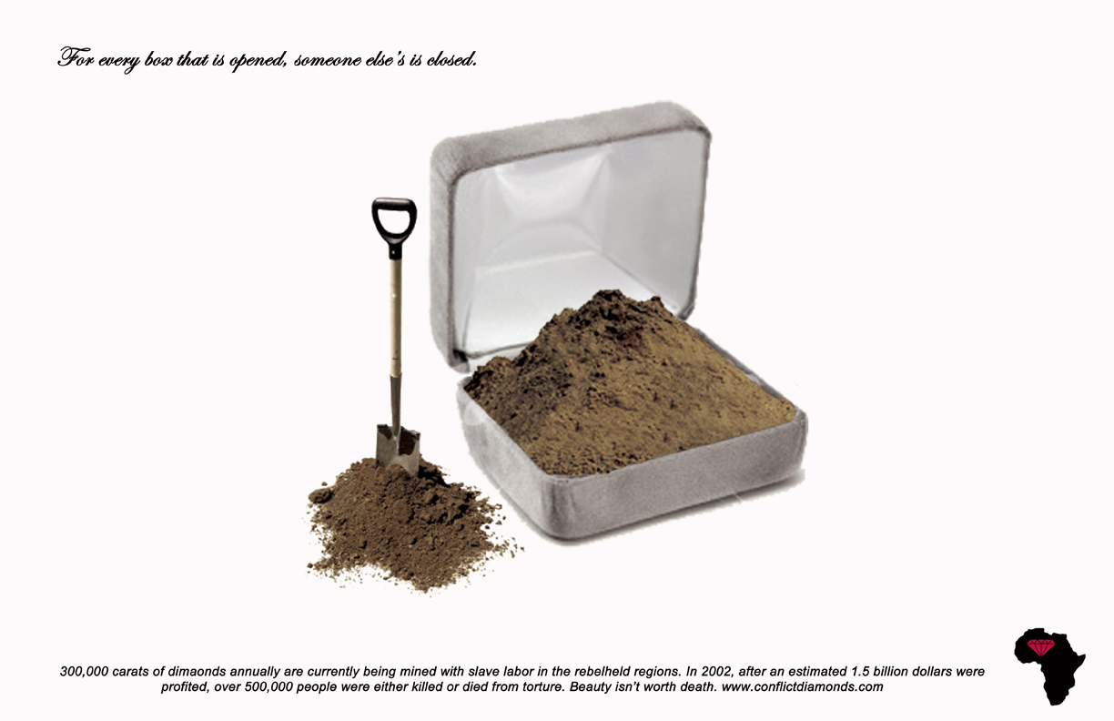

Slide 3


Slide 4
